Slide 1
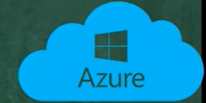
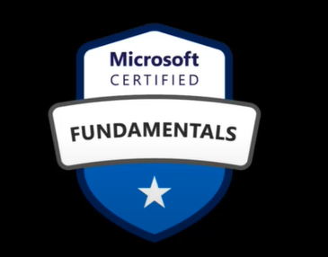
Microsoft Azure Fundamentals

Slide 2
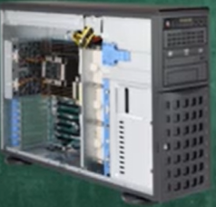
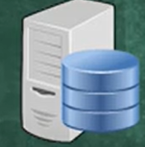
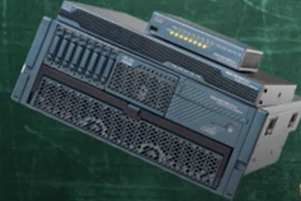

What is Cloud Computing?

Slide 3
CapEx vs OpEx
CAPEx
OPEx
Routers
Switches
Firewalls
Servers
License
Subscriptions
Heating
Ventilation
Air Conditioned
Electricity

Slide 4
Cloud Computing
Cloud Computing is a model for enabling ubiquitous , convenient , On-demand network access to a shared pool of configurable computing resources that can be rapidly provisioned and released with minimal management effort or service provider interaction.

Slide 5
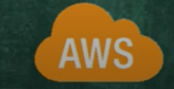
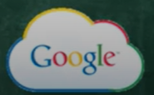
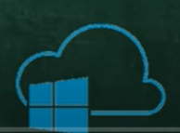
Cloud Providers
Amazon Web Services
Google Cloud
Microsoft Azure

Slide 6
Key Concepts and Terms
High Availability
Scalability
Elasticity
Fault tolerance
Disaster Recovery
Predictive Cost
Technical Skill Requirement

Slide 7
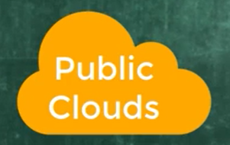
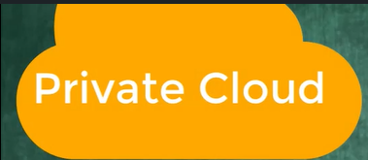
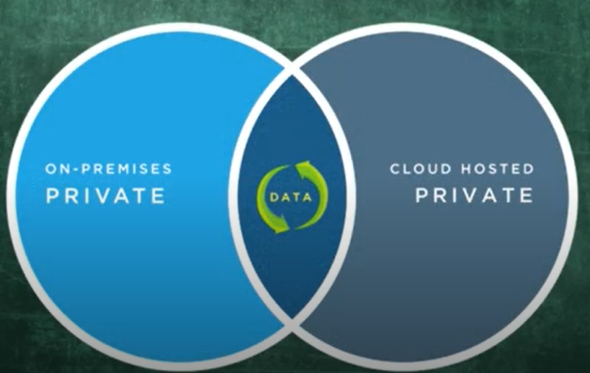
Types of Cloud Models
Public Cloud
Private Cloud
Hybrid Cloud

Slide 8
PUBLIC CLOUD
Ownership cloud provider
Multiple End Users
Public Access
Connectivity
Skills minimum

Slide 9
PRIVATE CLOUD
Ownership organization
Hardware
User
Connectivity
Skills some
Public Access

Slide 10
HYBRID CLOUD
Resource Location
Control
Skills

Slide 11
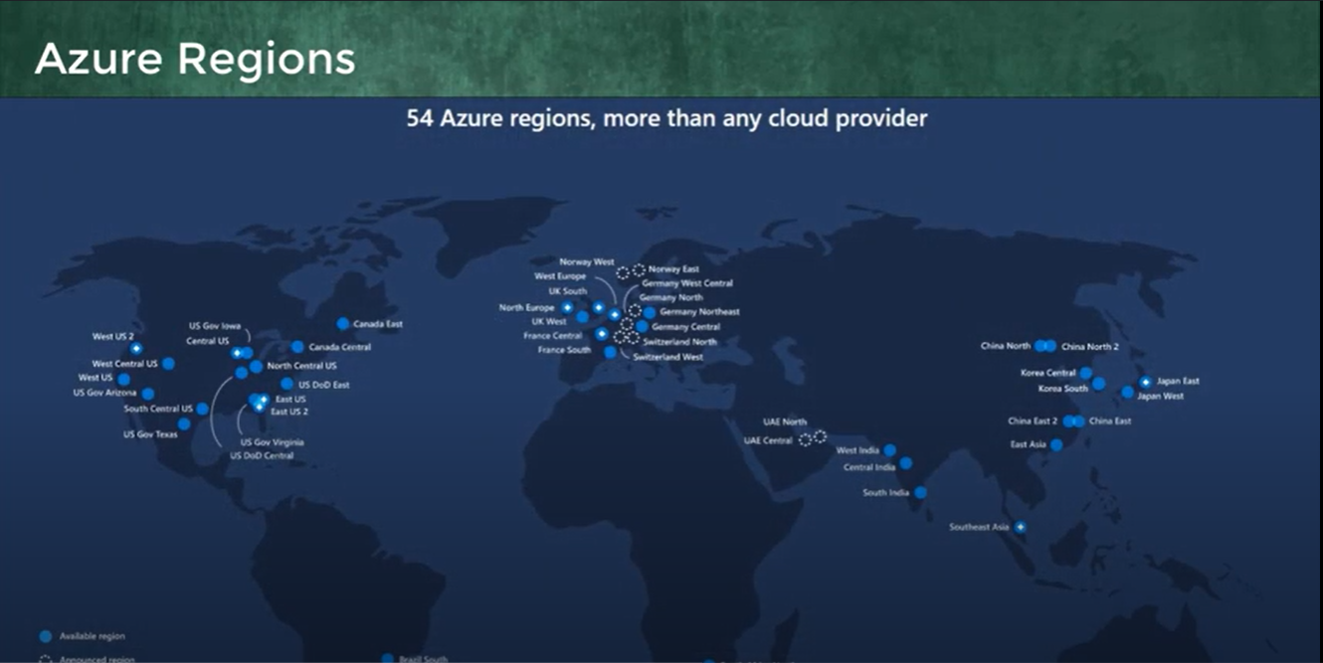
Azure Regions
54 Azure Regions , more than any cloud provider.

Slide 12
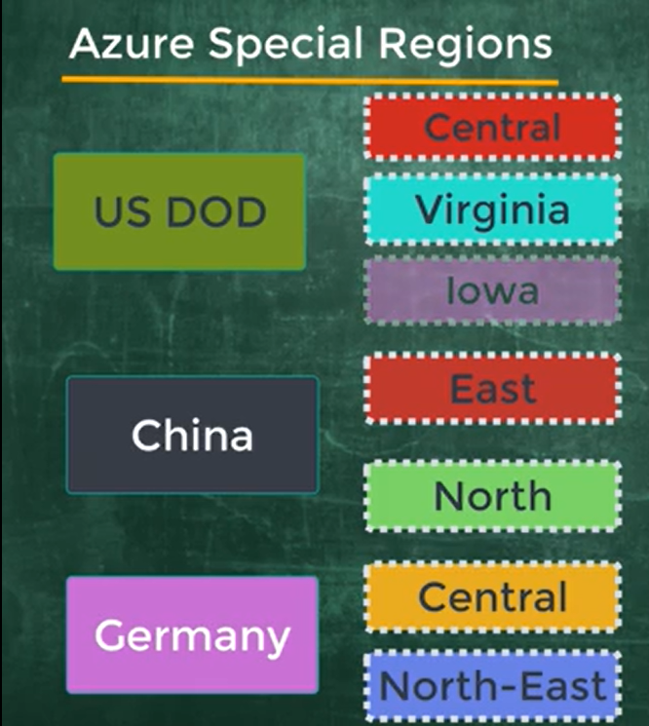
Special Regions

Slide 13
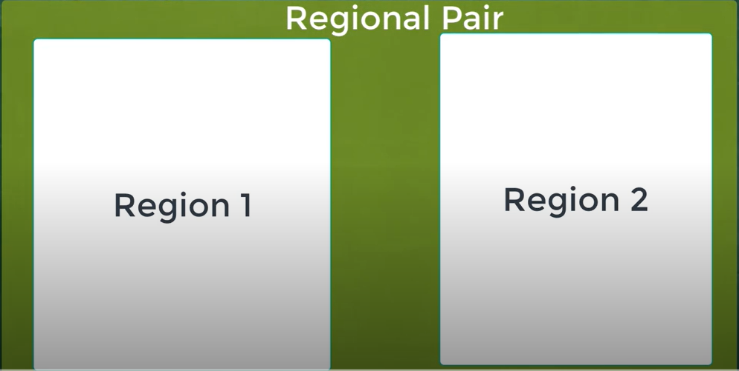
Regions Pairs
Geography.

Slide 14
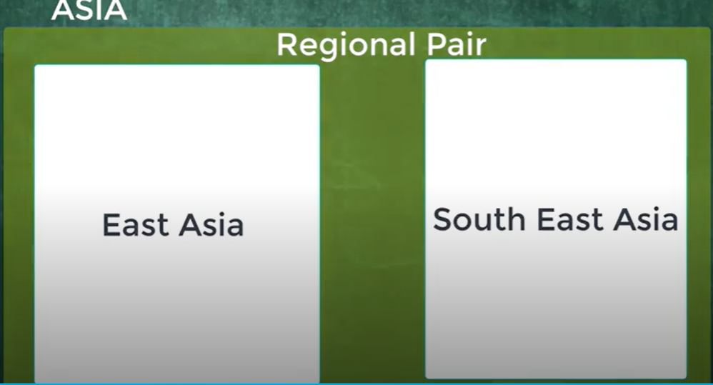
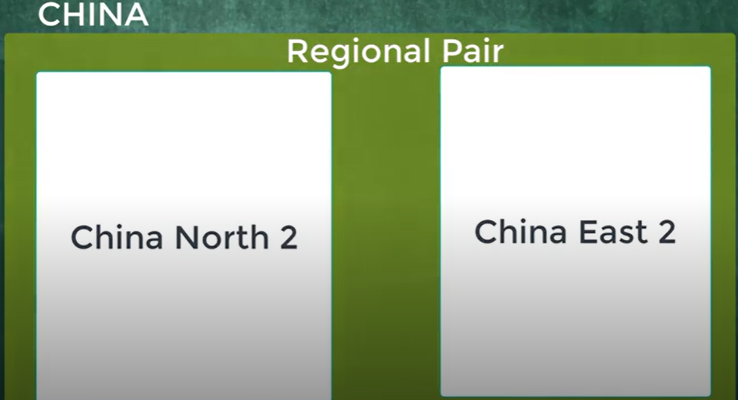
Regions Pairs
Geography.

Slide 15
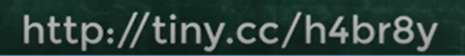
Feature Availability
All Azure service are NOT available in all regions.
Must Go through the below Site to know the availability.

Slide 16
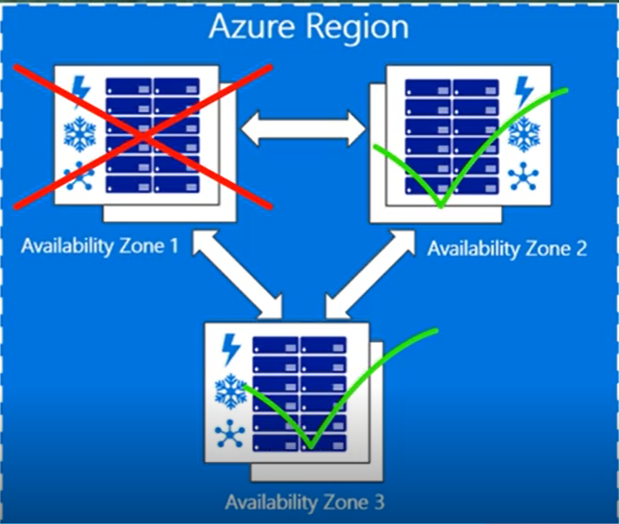
Availability Zone
Low latency.
High Availability.
Resiliency.
Minimum 3 Separate zones in each Region.

Slide 17
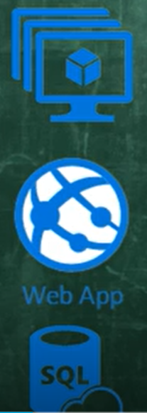
Resource Groups
Metering and billing.
Apply Policies.
Monitoring and Alerts.
Access Control.

Slide 18
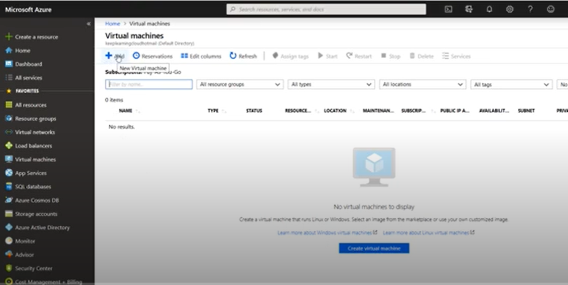
Virtual machines

Slide 19
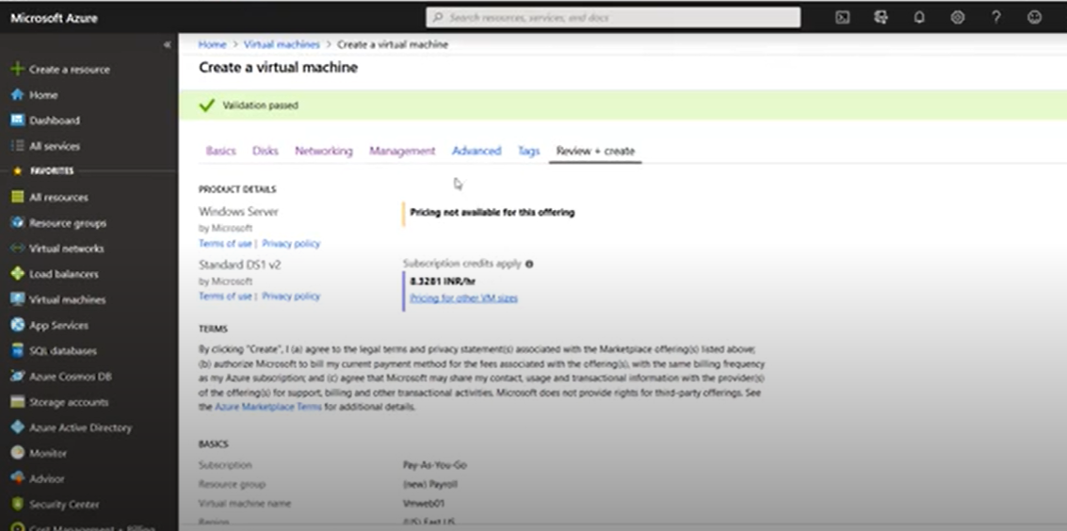
Virtual machines

Slide 20
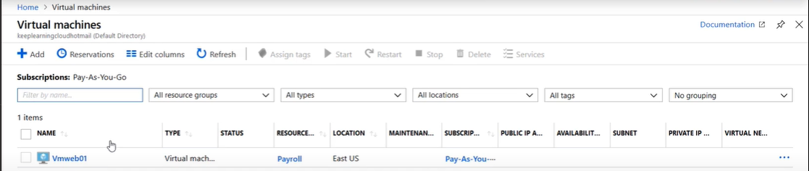
Virtual machines

Slide 21
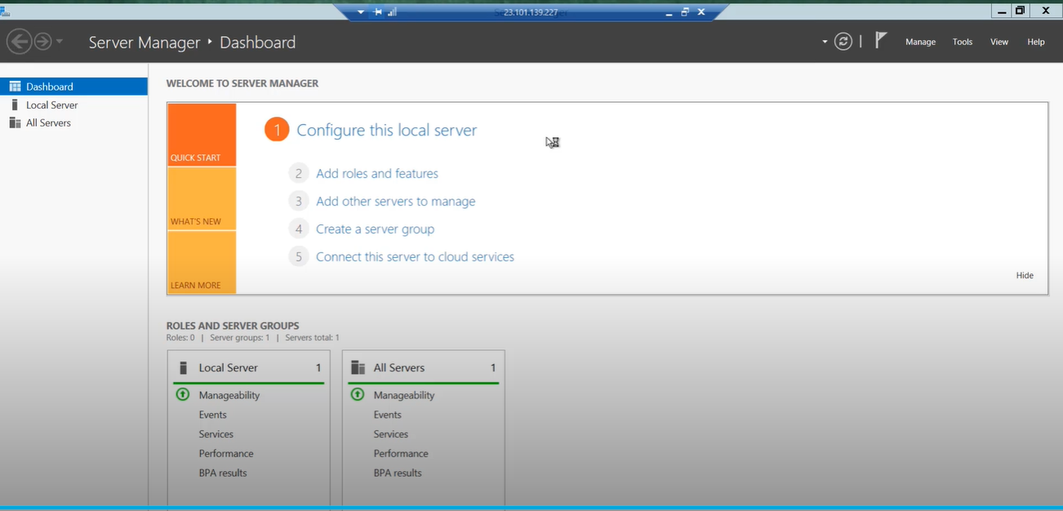
Virtual machines

Slide 22
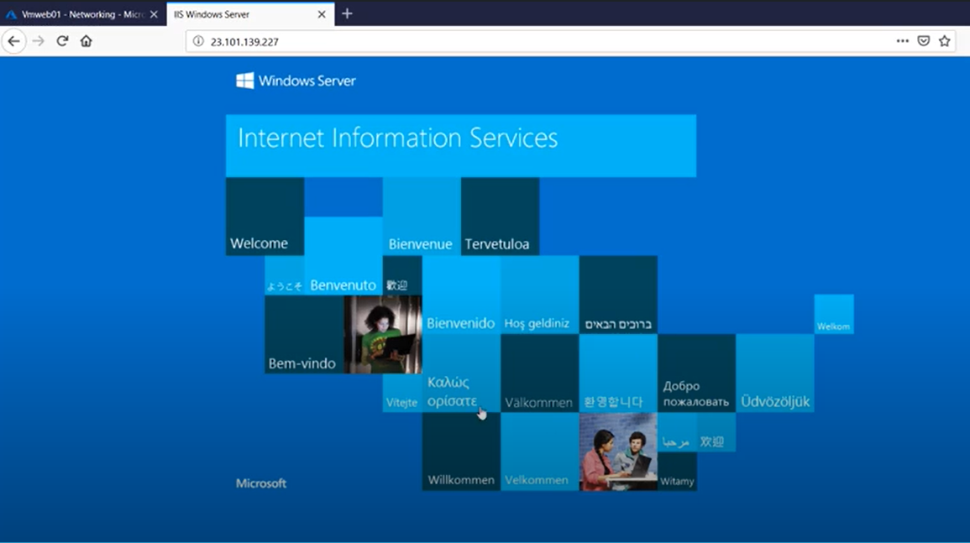
Virtual machines

Slide 23
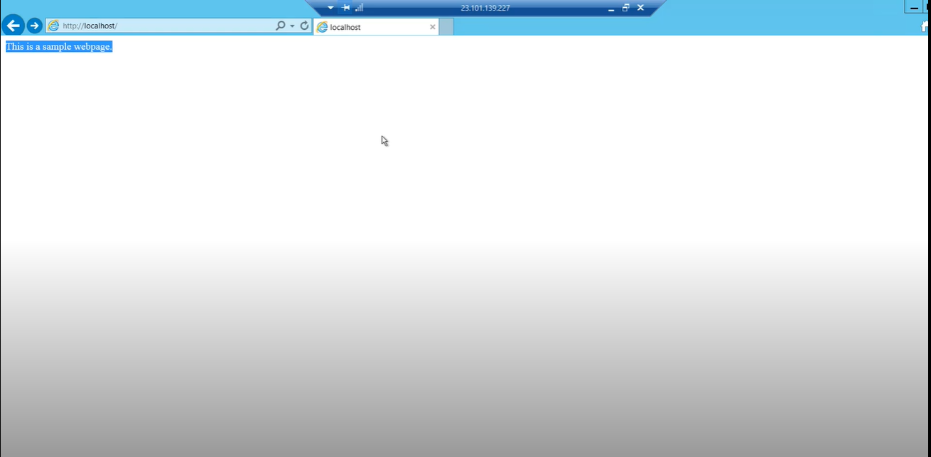
Virtual machines

Slide 24
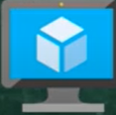
Virtual Networks(Vnet)
Resources
Virtual Machine 1
Virtual Machine 2

Slide 25
Subnet
No Vnet can be deployed with a Subnet.
In one Vnet we can create Multiple Subnets.
one Subnet we can will Provide Multiple IP Address to host the Resources.
250 IP Address
250 IP Address
Subnet1
Subnet2
Virtual Networks

Slide 26
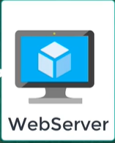
Azure Load Balancer
Azure Users
Error 404
Load Balancer

Slide 27
Azure VPN Gateway
Virtual Networks A
VPN Gateway
Virtual Networks B
Site-to-Site VPN Connections.
Point-to-Site VPN Connections.
Vnet-to-Vnet VPN Connections.

Slide 28
Data Storage
Structured Data (Name, DOB)
Semi Structured Data ( json, xml files).
UnStructured Data(mp4, jpg) .

Slide 29
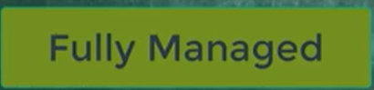
Azure Database Services
Cosmos DB(No SQL)
Azure SQL

Slide 30
Azure Big Data and Analytics
Azure SQL Data WareHouse.
Azure HDInsights.
Azure Data Lake Analytics .

Slide 31
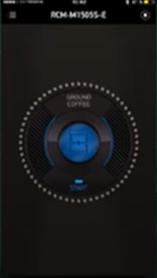
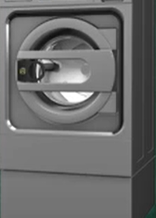
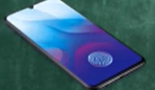
Internet of Things(IOT)
IOT is a system of computing devices to connect over the internet.

Slide 32
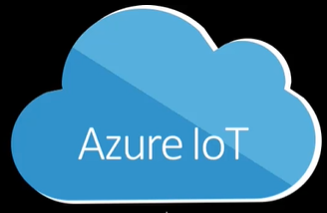
Azure IOT HUB
Clock
Coffee
Refrigerator
Washing Machine

Slide 33
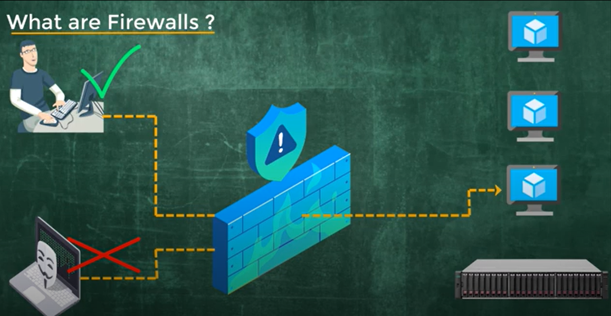
Azure Firewalls

Slide 34
Azure Active Directory

Slide 35
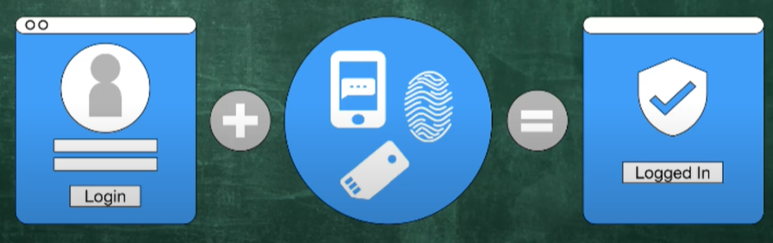
Azure Multifactor Authentication

Slide 36
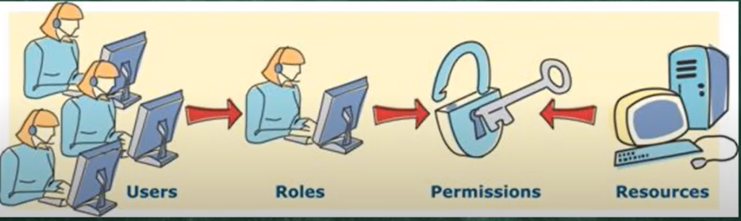
Role Base Access Controls(RBAC)

